Slide 1
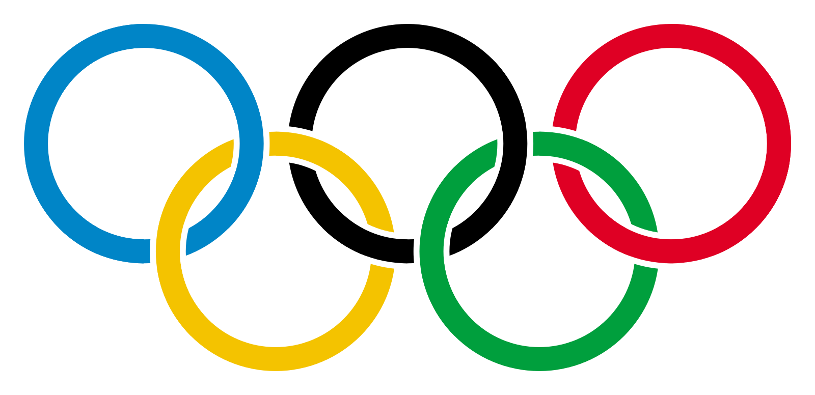
My Olympic Dream
Angie, Ryan, Tristan, & Ty

Slide 2

Motivation
Basis
2020 Tokyo Olympic games
Apparent lack of Olympic research, especially prediction
Interested in identifying factors that predict medal success
Goals
Gender differences
Is GDP predictive of medal success?
Is there a host-country advantage?
Does body mass index (BMI) predict medal success?
Specifically with respect to men’s 100 yard dash
Notes:
Core message:
With the summer Olympics taking place this summer we tried to identify factors that may contribute to high medal count in Olympics games.
Questions:
Does country GDP play a factor in medal counts?
Does hosting the Olympic games increase medal count for host country?
Can you use BMI (body mass index) as a predictor for 100M Sprinter gold medal winners (male) over time?
Does country GDP play a factor in medal counts?
What: fill in
Where: Olympic data .csv + world bank .csv (GDP)
Does hosting the Olympic games increase medal count for host country?
What: fill in
Where: Olympic data .csv
Can you use BMI (body mass index) as a predictor for 100M Sprinter gold medal winners (male) over time?
What: Narrow to male Olympic 100M Sprinters, find Height + Weight, calculate BMI, index by Olympic games year.
Where: Olympic data .csv

Slide 3

Data Munging
Dataset obtained from Kaggle
Web-scraped data (https://www.kaggle.com/heesoo37/120-years-of-olympic-history-athletes-and-results)
Post WWII data only (1948 and beyond)
Broken down by summer and winter games
GDP data taken from World Bank 2000 to 2018 (https://data.worldbank.org/indicator/NY.GDP.MKTP.CD)
Notes:
Questions sufficiently answered?
Top three questions are based on Olympic data over time. We found it challenging to sufficiently answer our inquiries because of the limited data set you work with when limited to specific games.
We only reviewed Olympic games post WW2, which further narrowed the available data set.
Exploration and Clean-up Process
Researched potential data sets (API and .csv) We tried/wanted to use the Olympic API from Apiary, but the formatting and documentation was very challenging to follow. Due to time constraints we decided to go with a .csv.
Basic clean up: Created clean .csv which only contained post WW2 Olympic games (1948). Made two dataframes from that clean file where we separated summer and winter Olympic data.
Interesting Insights:
Totals medals in each category (G, S, B) can vary greatly within a single year. Ex. Tie for third results in two bronze medals to one gold and silver.
M to F counts for winter games have increased at the same rate since WW2, while F athletes increased at a much faster rate in summer games after 1980.
Since the mid-nineties, summer games have not seen much of a fluctuation in total athletes, while winter games have seen an increase of about 56%.
The US peaked in the 96 summer games with just over 800 athletes and have reduced to 700 in the 2016 games.
Challenges:
When looking to analyze sprinter predictions by BMI it would have been nice to have a few more data points like 100M time, start reaction time, etc.
Fill in
Fill in

Slide 4

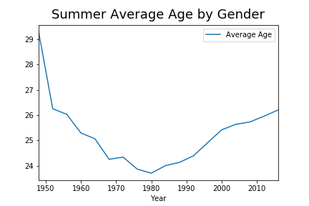
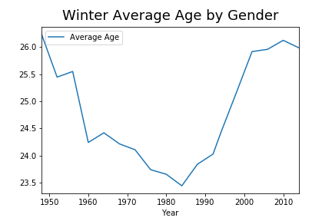
Age Analysis

Slide 5

Extra
According to the Wall Street Journal:
“Advances in sports science are helping preserve skilled but aging athletes. New ideas about training have lengthened their careers. And the surge in funding for athletes, fueled by skyrocketing broadcast-rights fees for the Olympics, finally makes it possible for competing in the Olympics to be a full-time job.”
(Bachman & Cohen, 2000)

Slide 6

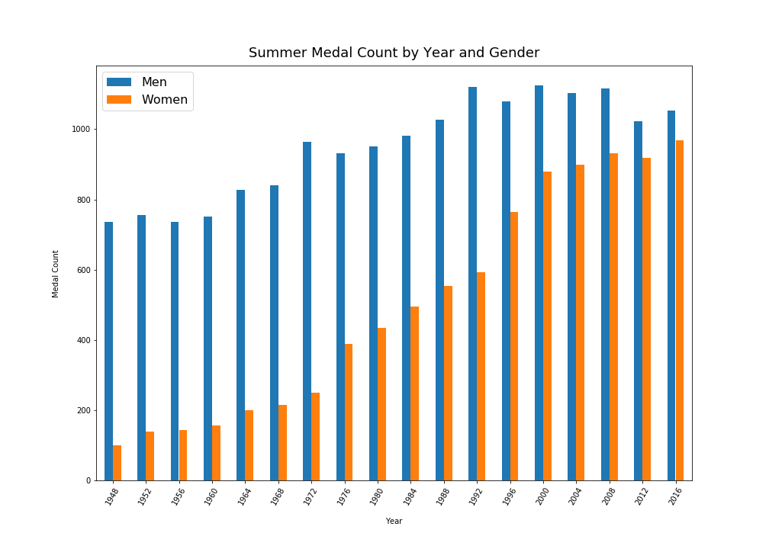
Gender Analysis
Gender equity in events has increased over time

Slide 7

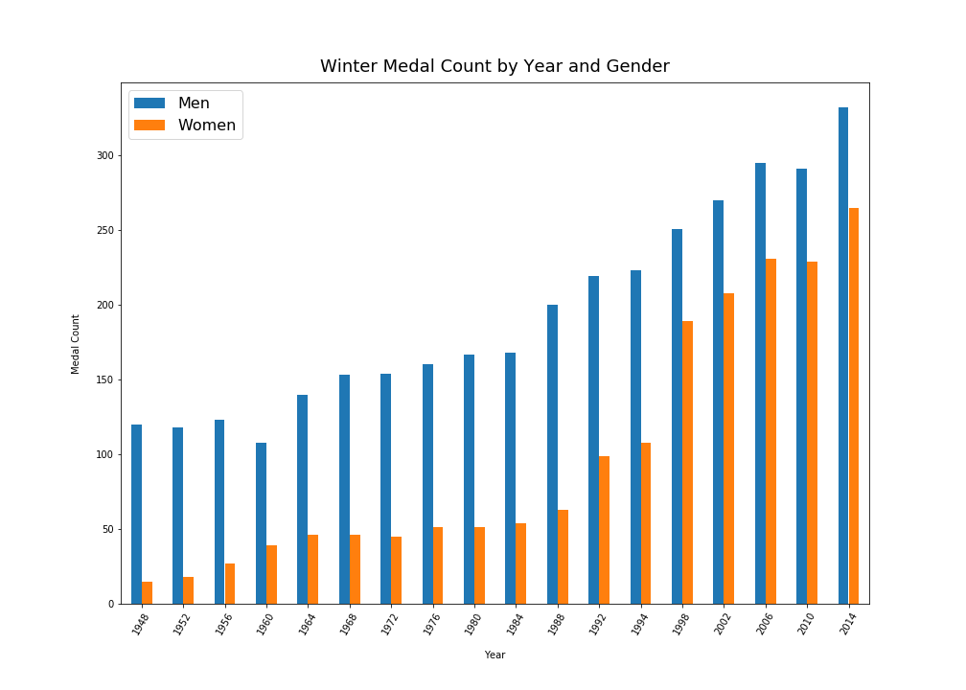
Gender Analysis

Slide 8

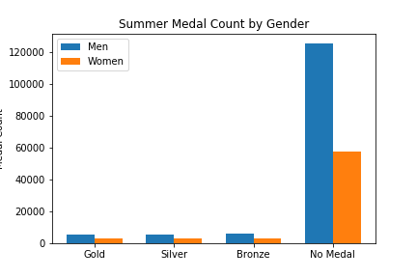
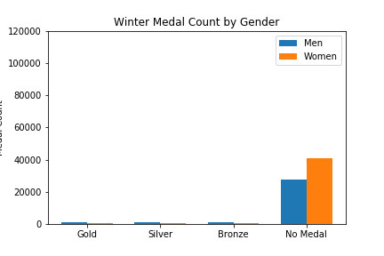
Gender Analysis
Vast number of athletes don’t medal
Medal Count
Medal Count

Slide 9

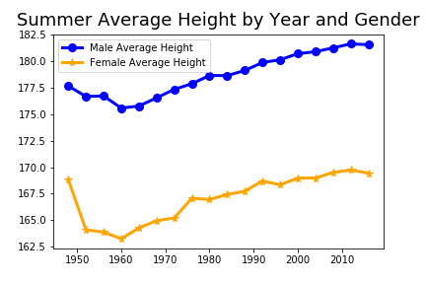
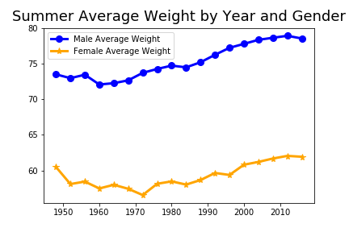
Gender Analysis
Kilograms
Centimeters

Slide 10

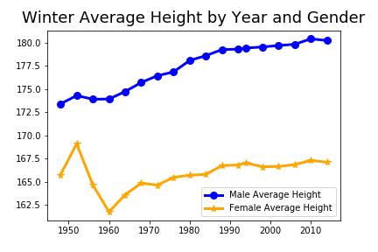
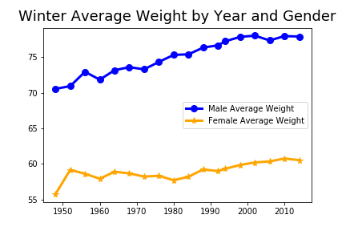
Gender Analysis
Kilograms
Centimeters

Slide 11
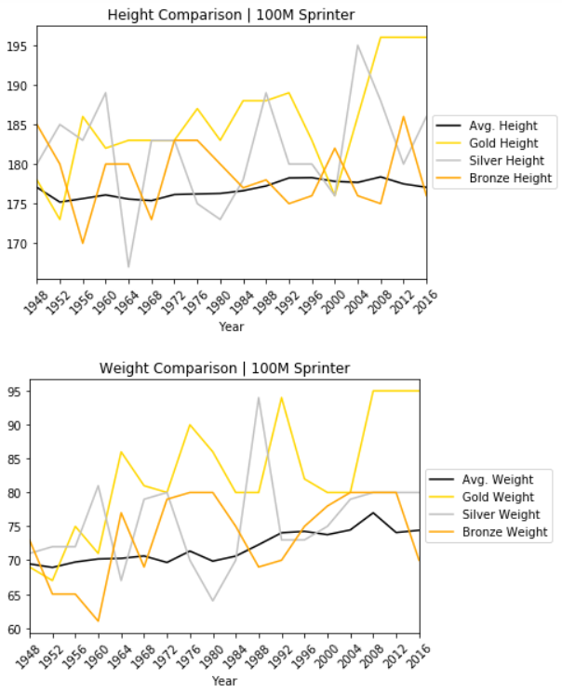
100M Sprinter Gold - Insights
Gold medal winners appear to be taller and heavier than average
Since 1948, gold medal winner weight has increased from 69 tp 95 kgs—increase of 38% or 26k (57 lbs)
Since 1956, gold medalists have been heavier than the average sprinter every year
Fairly-high degree of variance between medal winners from year to year
3-time gold medalist Usain Bolt is a very tall strong runner compared to previous medalists dating back to WW2

Slide 12

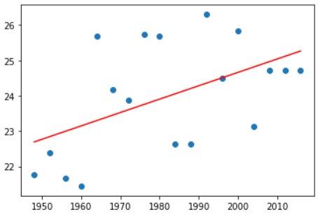
100M Sprinter Gold - Predictions
Does BMI predict 100M sprinter gold medal winners over time?
r = .51
r² = .26
About 25% of the variation in medal success is accounted for by BMI
We can predict with a low degree of certainty that 100M sprinter gold medalist in summer 2020 games will have BMI of 25.3

Slide 13

GDP Analysis
Does GDP predict medal success?
Sourced GDP data from the World Bank
Data munging: how did we handle missing data?
Merging clean GDP dataset to the Olympic dataset
Performed regression analysis

Slide 14

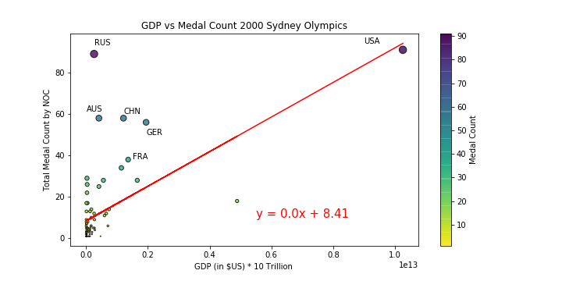
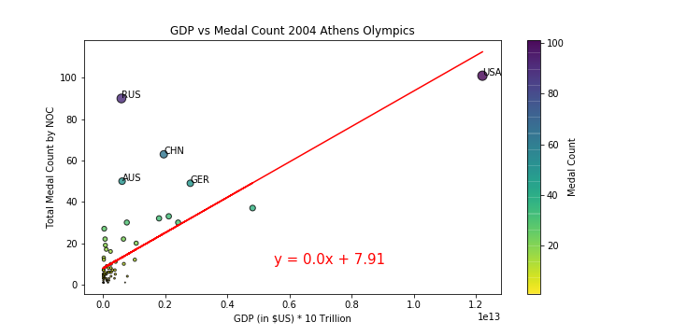
GDP Analysis
2000 Sydney Olympics (r = 0.60)
2004 Athens Olympics (r = 0.72)

Slide 15

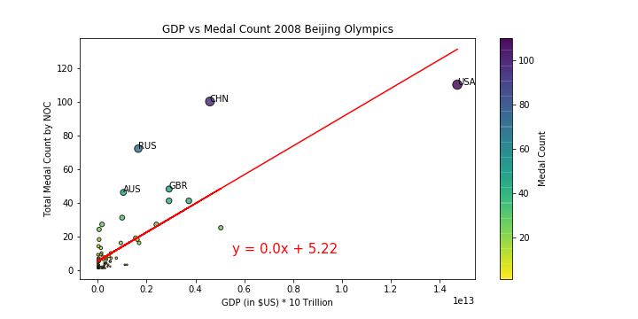
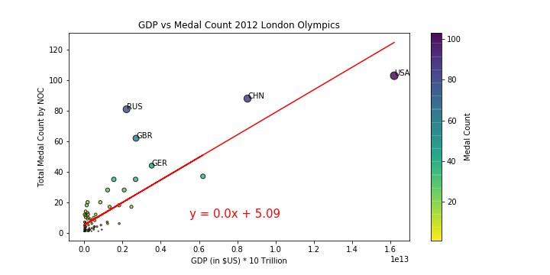
GDP Analysis
2008 Beijing Olympics (r = .80)
2012 London Olympics (r = 0.83)

Slide 16

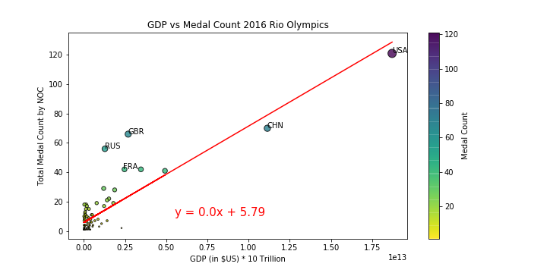
GDP Analysis
2016 Rio Olympics (r = 0.86)

Slide 17

GDP Analysis
r² of GDP Regressed on Medal Count by Summer Games
Summer Games | r²
2000 Sydney | .36
2004 Athens | .52
2008 Beijing | .65
2012 London | .69
2016 Rio de Janeiro | .75

Slide 18

GDP Analysis
r² of GDP Regressed on Medal Count by Winter Games
Winter Games | r²
2002 Salt Lake City | .27
2006 Torino | .15
2010 Vancouver | .36
2012 Sochi | .17

Slide 19

Hosting
Hosting versus Medal Count…is there a correlation?
Filter the data for post WWII
Divide the medal results into summer and winter games
Concentrate on the summer games in anticipation of Tokyo 2020
Find data for host countries and years: https://www.downloadexcelfiles.com/wo_en/download-excel-file-list-olympic-host-cities#.XjW0N2hKhPY
Verify the data with Wikipedia

Slide 20

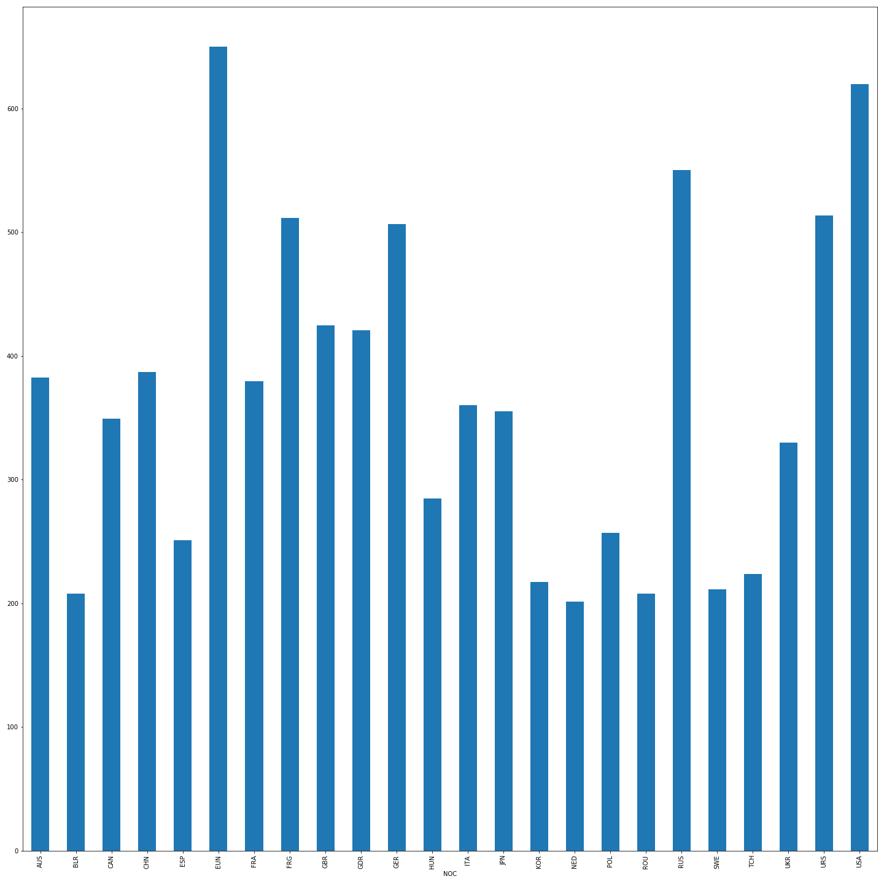
Hosting
A question occurs: what countries field the largest teams?
Nothing too deep here, what else can we uncover?

Slide 21

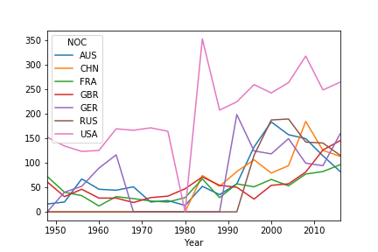
Hosting
A question occurs: can we predict which countries will lead in the medal count in 2020?
This leads us to a deeper question…

Slide 22

Hosting
A question occurs: does hosting the games lead to an increase in medal count?
A problem creeps up: the distribution of medals does not appear to be normal (backed up by SciPy’s normaltest()).
The solution: take the difference in a country’s medal count between the years when a country hosted the summer games and the average of the summer games before and after.
Apply the Wilcoxon test to this new dataset (SciPy’s wilcoxon())
According to this test, we reject the null hypothesis.

Slide 23

Post Mortem
Problems
Difficulty locating API
Coding is hard
Further Questions
Identify additional factors that could be predictive of success
Professional sports leagues
Performance enhancing drugs
Country size

Slide 24

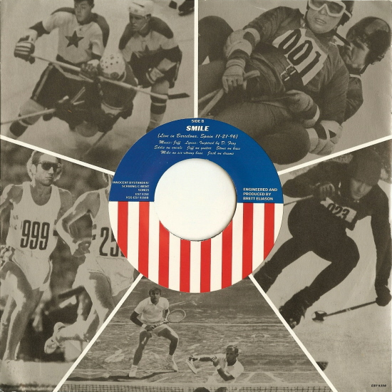

My Olympic Dream Performed by Pearl Jam ( 1996 fan club single) Written by Pearl Jam Sound Engineer Nick Didia
Questions

Slide 25
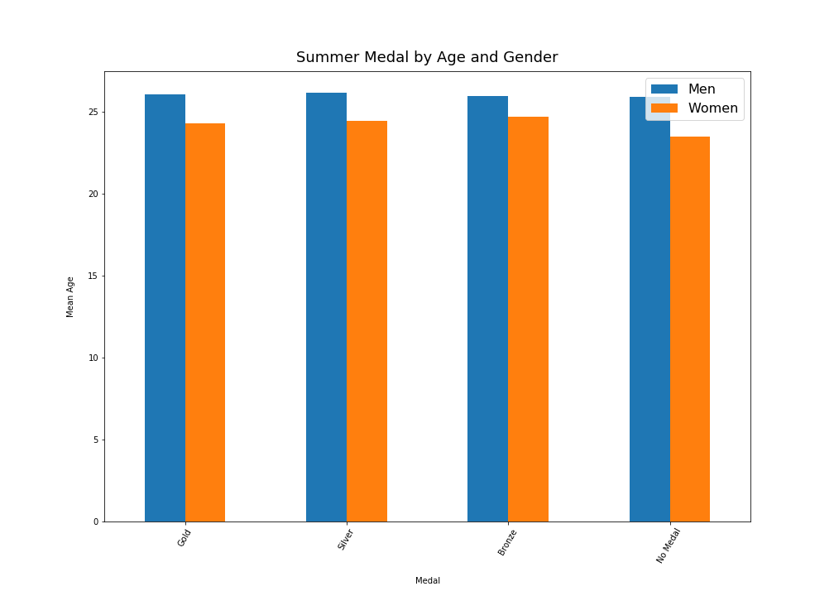
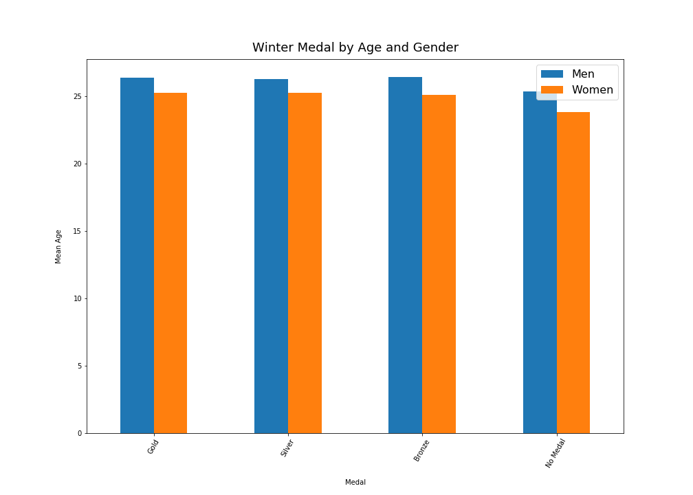
Age Analysis

Slide 26
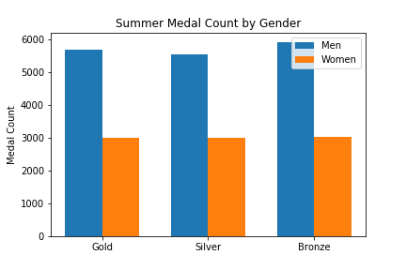
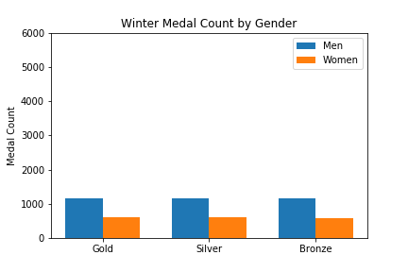
Gender Analysis

Slide 27
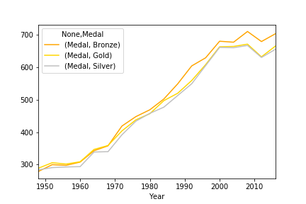
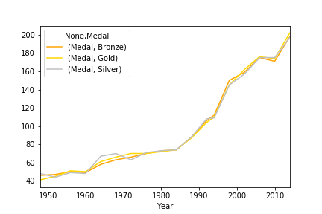
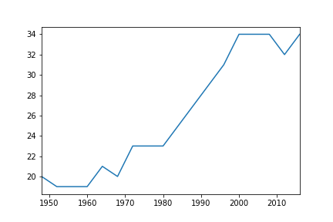
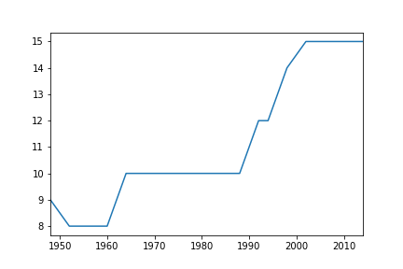
Medal Count vs TSports

Slide 28
My Olympic Dream Performed by Pearl Jam ( 1996 fan club single) Written by Pearl Jam Sound Engineer Nick Didia
Olympic dream, Olympic dream If I could reach to the sky and touch it for my country Get some on my finger and take in its smell The smell of victory, land of the free, Olympic dream Olympic Dream Olympic theme My Olympic dream My promotion scheme How hard can it be How high can I jump How high can I throw How high can I run (I’m running very fast) How long can I hold my breath and stay underwater And wave my legs around in perfect unison with my partner who doesn’t really understand me And my Olympic dream, my Olympic dream
I’ll be like Dwight Stones I’ll be like Bruce Jenner I’ll be like that girl who trained all her life as a distance runner And then tripped with a quarter mile to go But I . . . I will get up and I will run I will run with the Georgia peach breeze and I . . .
I will win I will win my . . . my Olympic dream My Olympic dream The gold’s just not good enough And I don’t even think of bronze I’m living my life for Olympic Platinum I’ll sing like Whitney (sing like Whitney) My Olympic dream

Slide 29

Extra

Slide 30

Extra

Slide 31

Extra

Slide 32

Extra

Slide 33

Extra

